Slide 1
Ensembles Methods for Classification

Slide 2
Ensemble Methods
In a nutshell:
A combination of multiple learning algorithms with the goal of achieving better predictive performance than could be obtained from any of these classifiers alone
A meta-algorithm that can be considered to be, in itself, a supervised learning algorithm since it produces a single hypothesis
Tend to work better when there is diversity among the models
Examples:
Bagging
Boosting
Stacking
Random Forests

Slide 3
Methods for Constructing Ensembles
By manipulating the training set. Create multiple training sets by resampling the original data according to some sampling distribution.
By manipulating the input features. Choose a subset of input features to form each training set.
By manipulating the class labels. Transform the training data into a binary class problem by randomly partitioning the class labels into two disjoint subsets.
By manipulating the learning algorithm. Manipulate the learning algorithm to generate different models.

Slide 4





















Ensemble Methods Illustrated
Traditional:
Ensemble Method:
$$S$$
$$S$$
Different
training sets
and/or learning
algorithms
$$L_{1}$$
$$L_{1}$$
$$L_{2}$$
$$L_{3}$$
$$L_{4}$$
$$L_{5}$$
$$L_{6}$$
$$(x,?)$$
$$h_{1}$$
$$h_{1}$$
$$h_{2}$$
$$h_{3}$$
$$h_{4}$$
$$h_{5}$$
$$h_{6}$$
$$(x,?)$$
$$h^{∗}=f(h_{1},…,h_{6})$$
$$(x,y^{∗}=h_{1}(x))$$
$$(x,y^{∗}=h_{1}(x))$$

Slide 5
Boostrap aggregating (Bagging)
An ensemble meta-algorithm designed to improve the stability and accuracy of machine learning algorithms
Can be used in both regression and classification
Reduces variance and helps to avoid overfitting
Usually applied to decision trees, though it can be used with any type of method

Slide 6
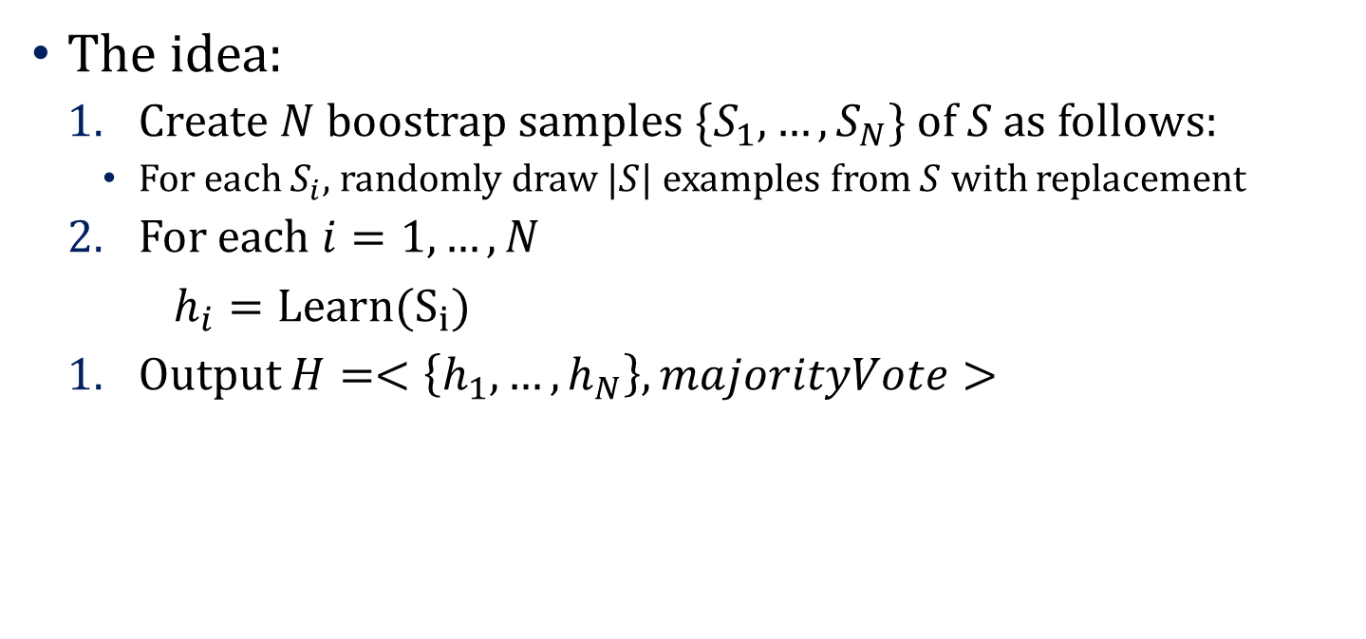
Bagging
The idea:
Create $N$ boostrap samples $\{S_{1},…,S_{N}\}$ of $S$ as follows:
For each $S_{i}$, randomly draw $|S|$ examples from $S$ with replacement
For each $i=1,…,N$
$h_{i}=Learn(S_{i})$
Output $H=<\left\{h_{1},…,h_{N}\right\},majorityVote>$

Slide 7
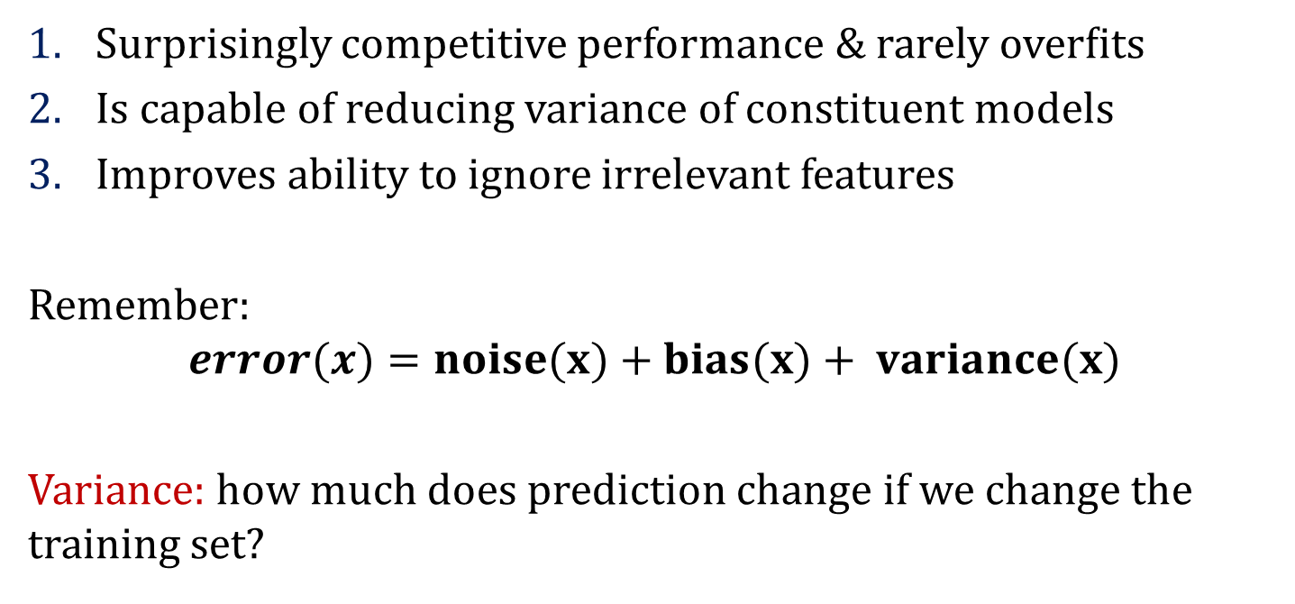
Most Notable Benefits
Surprisingly competitive performance & rarely overﬁts
Is capable of reducing variance of constituent models
Improves ability to ignore irrelevant features
Remember:
$$error(x)=noise(x)+bias(x)+ variance(x)$$
Variance: how much does prediction change if we change the training set?

Slide 8
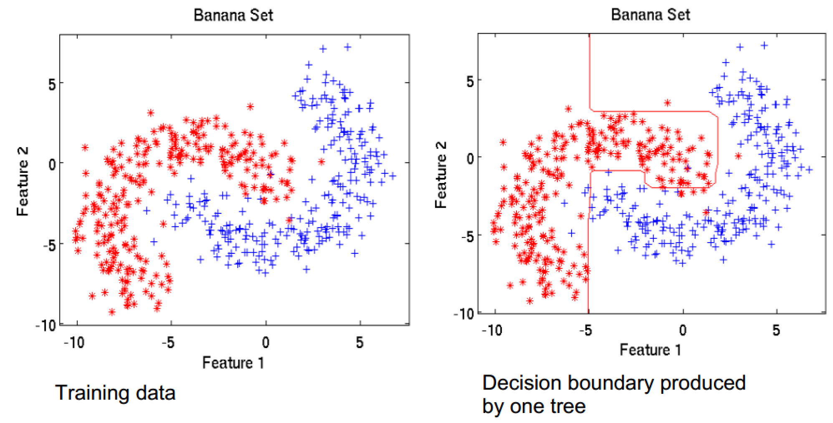
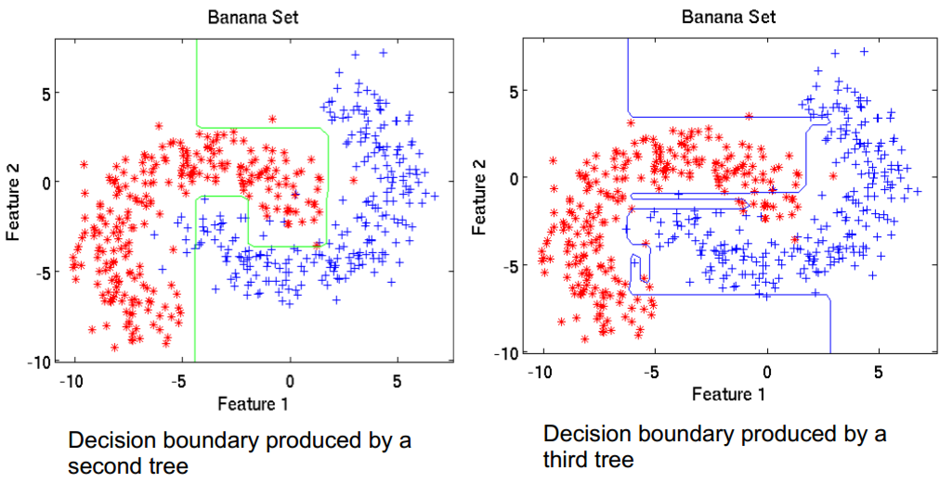
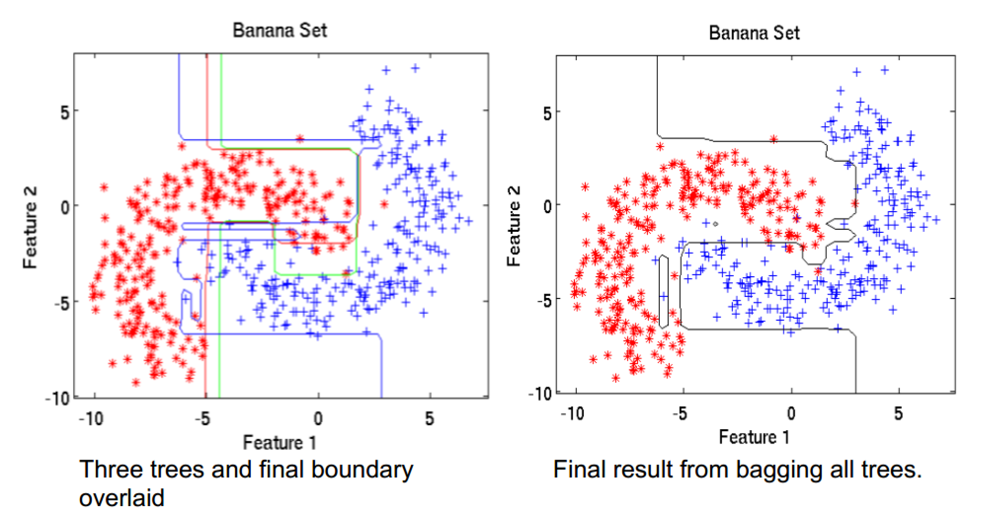
Bagging Example 1

Slide 9
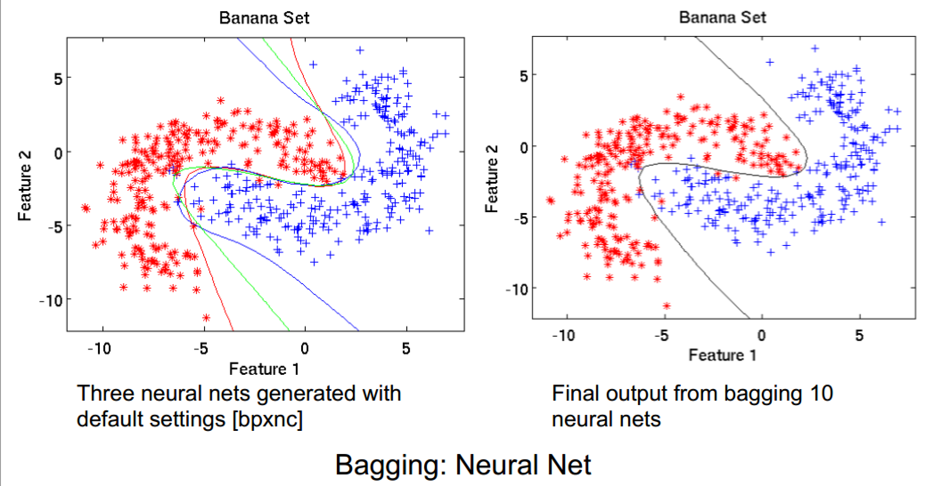
Bagging Example 2

Slide 10
Bagging Example 3 (2)
Accuracy: 100%

Slide 11
Bagging Summary
Works well if the base classifiers are unstable (complement each other)
Increased accuracy because it reduces the variance of the individual classifier
Does not focus on any particular instance of the training data
Therefore, less susceptible to model over-fitting when applied to noisy data

Slide 12
Boosting
Key differences with respect to bagging:
It is iterative:
Bagging: Each individual classifier is independent
Boosting:
Looks at the errors from previous classifiers to decide what to focus on for the next iteration
Successive classifiers depend on their predecessors
Key idea: place more weight on “hard” examples (i.e., instances that were misclassified on previous iterations)

Slide 13
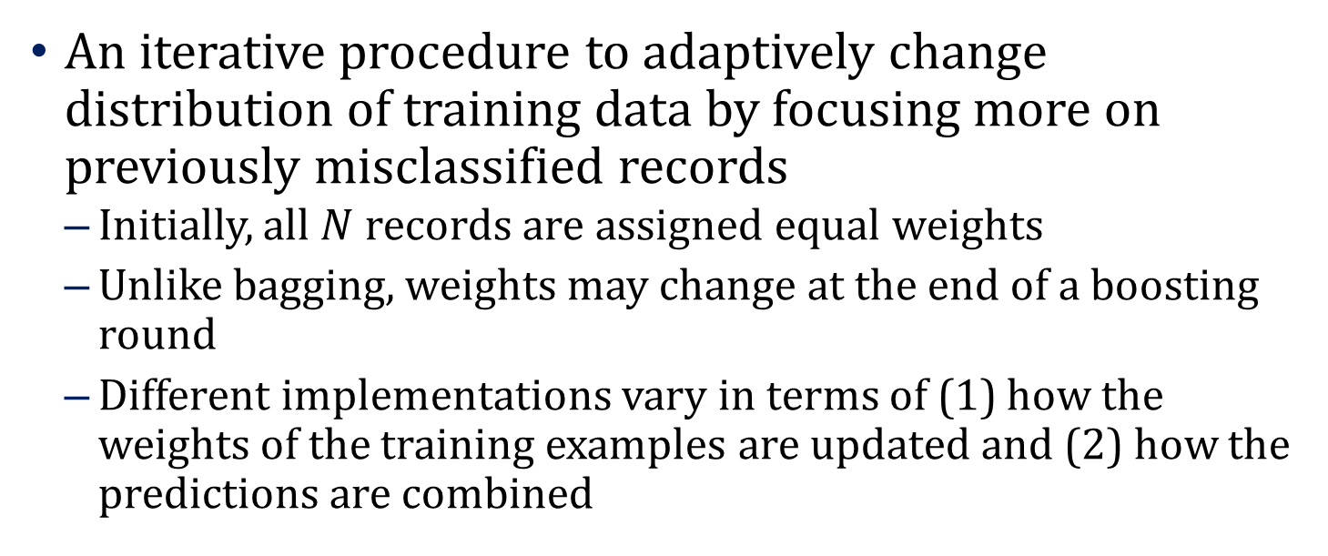
Boosting
An iterative procedure to adaptively change distribution of training data by focusing more on previously misclassified records
Initially, all $N$ records are assigned equal weights
Unlike bagging, weights may change at the end of a boosting round
Different implementations vary in terms of (1) how the weights of the training examples are updated and (2) how the predictions are combined

Slide 14
Boosting
Records that are wrongly classified will have their weights increased
Records that are classified correctly will have their weights decreased
Example 4 is hard to classify
Its weight is increased, therefore it is more likely to be chosen again in subsequent rounds

Slide 15
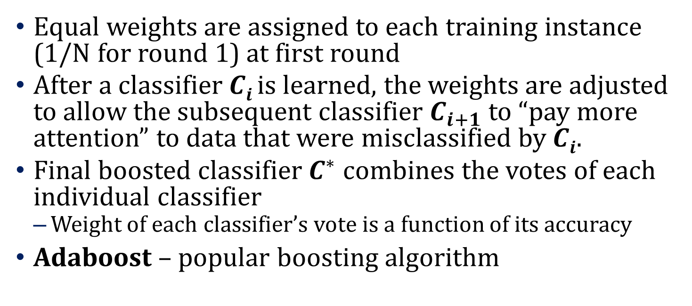
Boosting
Equal weights are assigned to each training instance (1/N for round 1) at first round
After a classifier $Ci$ is learned, the weights are adjusted to allow the subsequent classifier $C_{i+1}$ to “pay more attention” to data that were misclassified by $Ci$.
Final boosted classifier $C^{∗}$ combines the votes of each individual classifier
Weight of each classifier’s vote is a function of its accuracy
Adaboost – popular boosting algorithm

Slide 16
Adaboost (Adaptive Boost)
Input:
Training set D containing N instances
T rounds
A classification learning scheme
Output:
A composite model

Slide 17
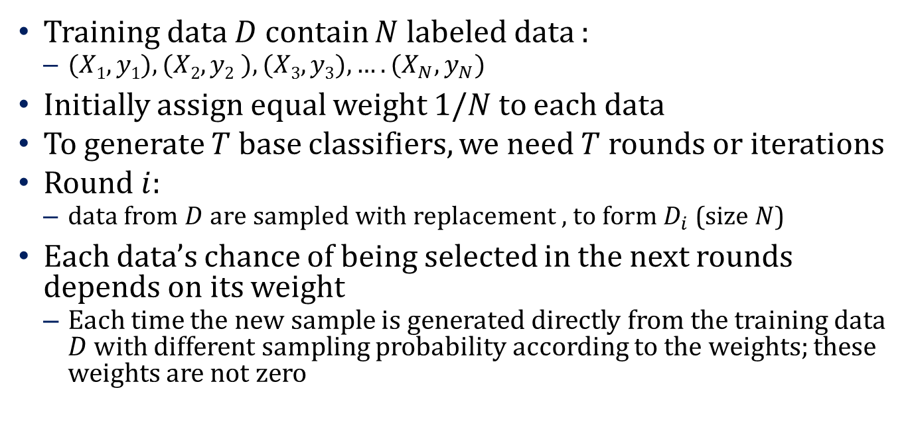
Adaboost: Training Phase
Training data $D$ contain $N$ labeled data :
$(X1,y1), (X2,y2 ), (X3,y3),….(X_{N},y_{N})$
Initially assign equal weight $1/N$ to each data
To generate $T$ base classifiers, we need $T$ rounds or iterations
Round $i$:
data from $D$ are sampled with replacement , to form $D_{i}$ (size $N$)
Each data’s chance of being selected in the next rounds depends on its weight
Each time the new sample is generated directly from the training data $D$ with different sampling probability according to the weights; these weights are not zero

Slide 18
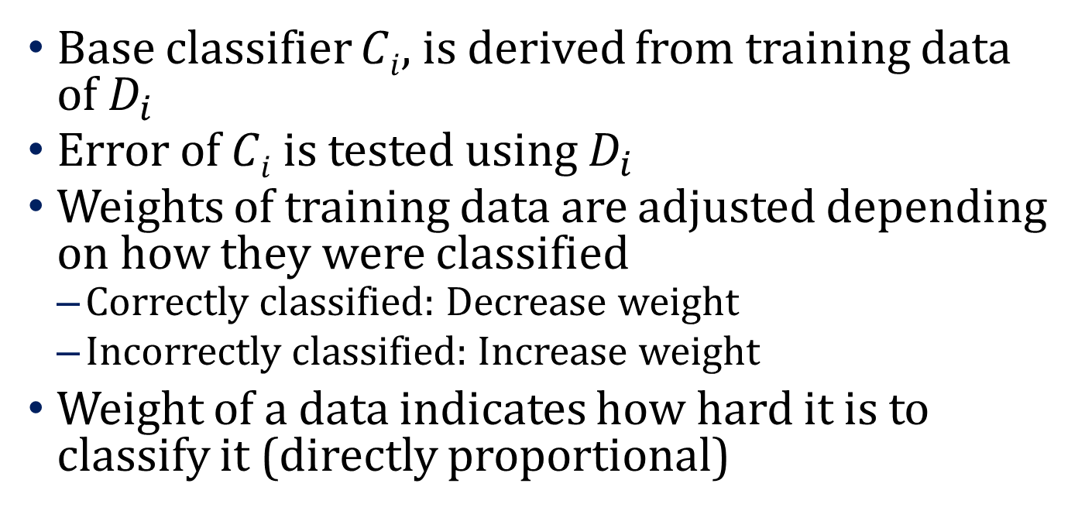
Adaboost: Training Phase
Base classifier $Ci$, is derived from training data of $D_{i}$
Error of $Ci$ is tested using $D_{i}$
Weights of training data are adjusted depending on how they were classified
Correctly classified: Decrease weight
Incorrectly classified: Increase weight
Weight of a data indicates how hard it is to classify it (directly proportional)

Slide 19
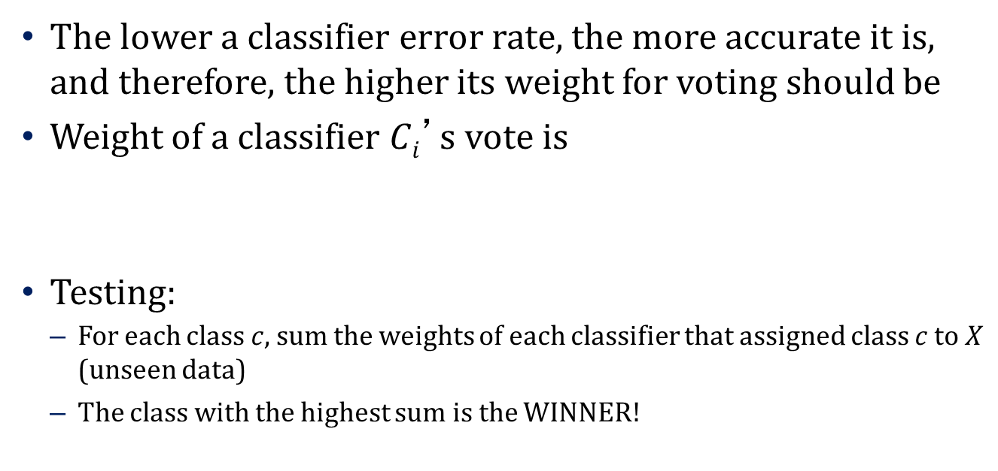
Adaboost: Testing Phase
The lower a classifier error rate, the more accurate it is, and therefore, the higher its weight for voting should be
Weight of a classifier $Ci$’s vote is
Testing:
For each class $c$, sum the weights of each classifier that assigned class $c$ to $X$ (unseen data)
The class with the highest sum is the WINNER!

Slide 20
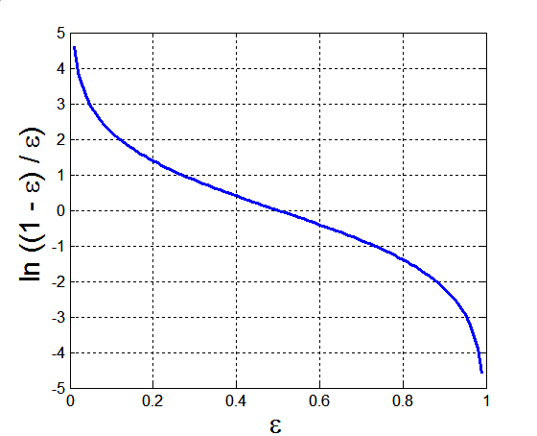
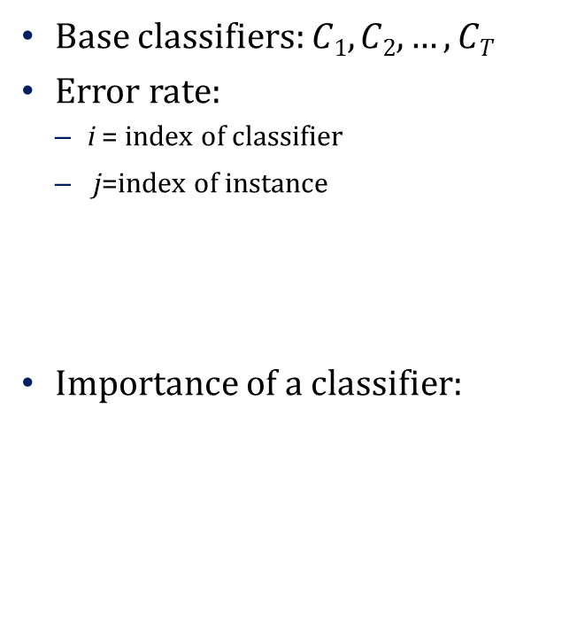
Example: Error and Classifier Weight in AdaBoost
Base classifiers: $C1, C2, …, CT$
Error rate:
i = index of classifier
j=index of instance
Importance of a classifier:

Slide 21

Example: Data Instance Weight in AdaBoost
Assume: $N$ training data in $D$, $T$ rounds, $(xj,yj)$are the training data, $Ci$, a_{i} are the classifier and weight of the i^{th} round, respectively
Weight update on all training data in D:

Slide 22
Illustrating AdaBoost
Initial weights for each data point
Data points for training

Slide 23
Illustrating AdaBoost

Slide 24
Bagging and Boosting Summary
Bagging: Resample data points Weight of each classifier is the same Only variance reduction Robust to noise and outliers | Boosting: Reweight data points (modify data distribution) Weight of classifier varies depending on accuracy Reduces both bias and variance Can hurt performance with noise and outliers
Boosting Python Code

Slide 25






Cute Kitten Picture Intermission

Slide 26
Stacked Generalization (Stacking)
Underlying idea: Learn whether training data have been properly learned
2 tiers of classifiers
If a particular base-classifier incorrectly learned a certain region of the feature space, the second tier (meta) classifier may be able to detect this undesired behavior
Along with the learned behaviors of other classifiers, it can correct such improper training

Slide 27
The Stacking Framework
There are two approaches for combining models: voting and stacking
Difference between the stacking framework and those previously discussed:
In contrast to stacking, no learning takes place at the meta-level when combining classifiers by a voting scheme
Label that is most often assigned to a particular instance is chosen as the correct prediction when using voting

Slide 28
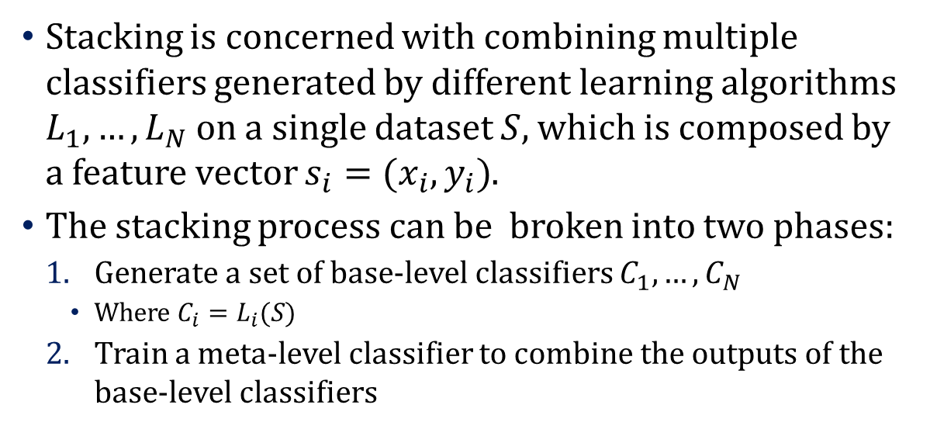
The Stacking Framework
Stacking is concerned with combining multiple classifiers generated by different learning algorithms $L_{1},…,L_{N}$ on a single dataset $S$, which is composed by a feature vector $s_{i}=(x_{i},y_{i})$.
The stacking process can be broken into two phases:
Generate a set of base-level classifiers $C_{1},…,C_{N}$
Where $C_{i}=L_{i}(S)$
Train a meta-level classifier to combine the outputs of the base-level classifiers

Slide 29








The Stacking Framework
Training Set
1
2
3
4
…
n
Hypotheses
…
← Training Observations
$${ h}_{1}$$
$${ h}_{2}$$
$${ h}_{3}$$
$${ h}_{n}$$
Predictions on Training Observations
…
$${ p}_{1}$$
$${ p}_{2}$$
$${ p}_{3}$$
$${ p}_{n}$$
Meta Learner
Meta Learner’s Hypothesis
H
← Test Observation
Final Prediction
P

Slide 30
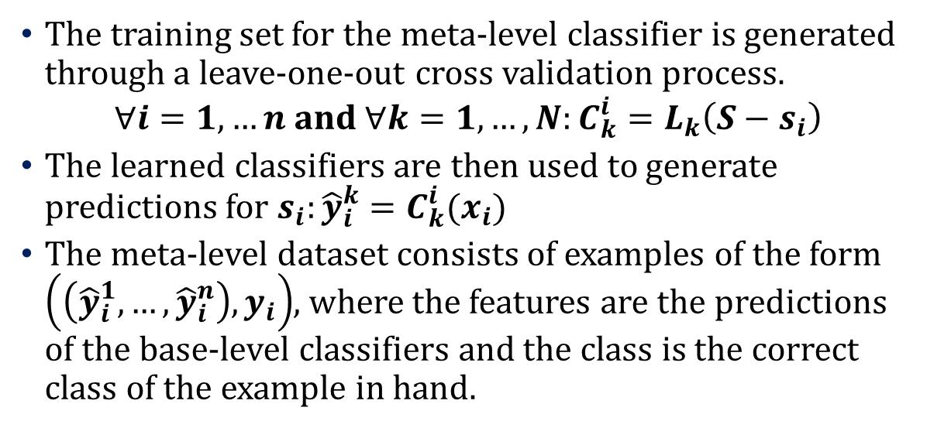
The Stacking Framework
The training set for the meta-level classifier is generated through a leave-one-out cross validation process.
$$∀i=1,…n and ∀k=1,…,N:C_{k}^{i}=L_{k}\left(S−s_{i}\right)$$
The learned classifiers are then used to generate predictions for $s_{i}:{\hat{y}}_{i}^{k}=C_{k}^{i}(x_{i})$
The meta-level dataset consists of examples of the form $\left(\left({\hat{y}}_{i}^{1},…,{\hat{y}}_{i}^{n}\right),y_{i}\right)$, where the features are the predictions of the base-level classifiers and the class is the correct class of the example in hand.

Slide 31
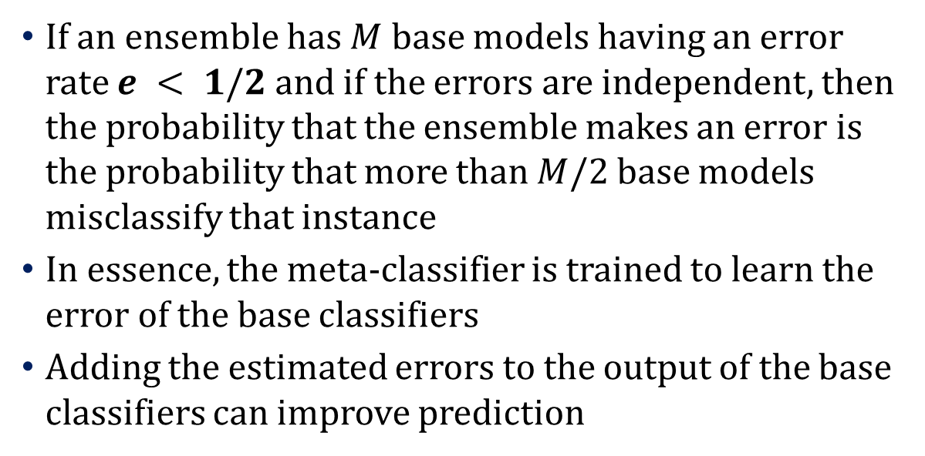
Mathematical Insight Into Stacking
If an ensemble has $M$ base models having an error rate $e < 1/2$ and if the errors are independent, then the probability that the ensemble makes an error is the probability that more than $M/2$ base models misclassify that instance
In essence, the meta-classifier is trained to learn the error of the base classifiers
Adding the estimated errors to the output of the base classifiers can improve prediction
Stacking Python Code

Slide 32
The Netflix Challenge
Netflix provided a training dataset of 100,480,507 ratings that 480,189 users gave to 17,770 movies.
Each training rating (or instance) is of the form
<user, movie, date of rating, rating >
The user and movie fields are integer IDs, while ratings are from 1 to 5 (integral) stars.

Slide 33
More on the Netflix Challenge
BellKor’s Pragmatic Chaos (1st place) was a hybrid team: KorBell (AT&T Research), which won the first Progress Prize milestone in the contest, combined with the Austrian team Big Chaos to improve their score
The Ensemble (2nd place) was also a composite team
BellKor’s Pragmatic Chaos submitted their solution 10 minutes earlier than the second-place team, The Ensemble, while the two teams’ algorithms were a perfect tie, score-wise
The dataset is still available (if you want to beat them)

Slide 34
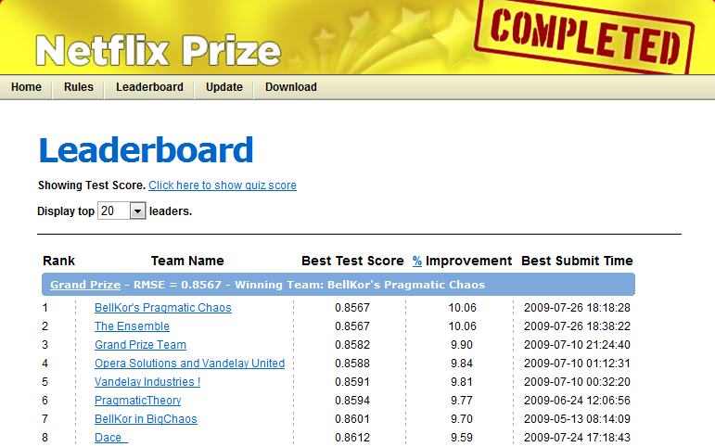
More on the Netflix Challenge

Slide 35
Random Forests Method
A class of ensemble methods specifically designed for decision tree classifiers.
Combines predictions made by many decision trees.
Each tree is generated based on a bootstrap sample and the values of an independent set of random vectors.
The random vectors are generated from a fixed probability distribution.

Slide 36
Random Forests: A Visual Explanation
Original Training Data
Step 1:
Create random vectors
D
Randomize
Step 2:
Use random vector to
build multiple decision trees
D₁
D_{t}
D₂
D_{t-1}
T₁
T₂
T_{t-1}
T_{t}
Step 3:
Combine decision trees
T*

Slide 37
Why use Random Vectors?
Recall that an underlying assumption of the ensemble process is that the base learners are independent.
As the trees become more correlated (less independent), the generalization error bound tends to increase.
Randomization helps to reduce the correlation among decision trees.

Slide 38
Random Forests Advantages
Empirically comparable classification accuracies to AdaBoost.
More robust to outliers and noise than AdaBoost.
Runs much faster than AdaBoost.
Produces useful internal estimates of error, strength, correlation, and variable importance.
Simple and easy to parallelize.

Slide 39
Random Forests Summary
Random forests can be thought of as combining bagging and random subspaces.
Bootstrap aggregated (bagged) trees.
Random subset of the input space (random subspaces).

